Slide 1
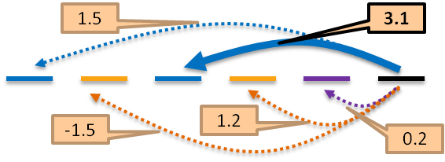



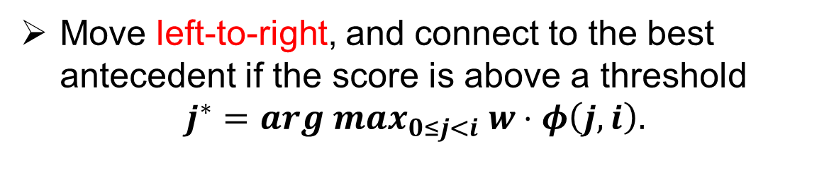

A Constrained Latent Variable Model for Coreference Resolution
Kai-Wei Chang, Rajhans Samdani and Dan Roth
Coreference Resolution
Abstract
Experiment Settings
Coreference resolution: clustering of mentions that represents the same underlying entity.
In the following example, mentions in the same color are co-referential.
An American official announced that American President Bill Clinton met his Russian counterpart, Vladimir Putin, today. The president said that Russia was a great country.
We describe the Latent Left Linking model (L3M), a linguistically motivated latent structured prediction approach to coreference resolution. L3M is a simple algorithms that extends existing best-link approaches; it admits efficient inference and learning and can be augmented with knowledge-based constraints, yielding the CL3M algorithm. Experiments on ACE and Ontonotes data show that L3M and CL3M are more accurate than several state-of-the-art approaches as well as some structured prediction models.
Evaluation on Ontontes-5.0 (used in CoNLL ST 12’)
3,145 annotated documents from various sources including newswire, bible, broadcast transcripts, web blogs
Evaluation metric: average F1 scores of MUC, BCUB and Entity-based CEAF
Performance on Ontonotes v5.0 data
Mention Pair Scorer
Latent Left-Linking Model
Incorporating Constraints
Keys:
Each item can link only to an item on its left (creating a left-link)
  Score of a mention clustering is the sum of the left-links
  $s\left(C;d,w\right)=\sum_{i=1…m_{d}, \left(j, i\right) is a left−link}{w⋅φ(j,i)}$
Pairwise Scoring function is trained jointly with Best-Link inference.
  Inference:
Find the best clustering $C$ to maximize $s\left(C;d,w\right)$
  $$\max_{C}{s\left(C;d,w\right)}=\sum_{i=1…m_{d} }{\max_{0≤j<i}{w⋅φ\left(j,i\right)}.}$$
Can be solved by the Best-Link algorithm
  Learning:
  Learning involves minimizing the function:
$L\left(w\right)=\frac{λ}{2}||w||^{2}+$ $\frac{1}{|D|}\sum_{d∈D}{\frac{1}{m_{d }}(\max_{c}(s\left(C;d,w\right)+Δ\left(C,C_{d}\right))}−s(C_{d};d,w).$
Can be solved by CCCP (Yuille and Rangarajan 03)
We use a fast stochastic sub-gradient descent procedure to perform SGD on a per-mention basis
Sub-gradient of mention i in document d
Inference: maximize a constraint-augmented scoring function
$ψ_{p}$ are constraints and $ρ_{p}$ are their corresponding coefficients.$ψ_{p}\left(d,C\right)=1,$ if constraints are active (on)
Must-link: Encourage mention pairs to connect
SameProperName: two proper names with high similarity score measured by Illinois NESim
SameSpam: share the same surface text
SameDetNom: both start with a determiner and the wordnet-based similarity score is high
Cannot-link: Prevent mention pairs from connecting
ModifierMisMatch: head modifiers are conflicted
PropertyMismatch: properties are conflicted
When using hard constraints ($ρ_{p}=±∞)$, inference can be solved by a greedy algorithm similar to the Best-Link algorithm
Mentions are presented in a left-to-right order
The most successful approach over the last few years has been Pairwise classification (e.g., Bengtson and Roth 2008)
For each pair $(i,j)$, generate a compatibility score
$$Score\left(i,j\right)=w^{T}φ\left(j,i\right)$$
Features $φ\left(j,i\right)$include:
Lexical Features: edit distance, having the same head words,...
Compatibility: gender (male, female, unknown), type, number…
Distance: #mentions/#sentences between $i,j$
Existing works train a scorer by binary classification (e.g, Bengtson and Roth 2008)
Suffer from a severe label imbalance problem
Training Is done independently of the inference step (Best-Link Inference).
Performance on Name Entities
Best-Link Inference
Ablation Study on Constraints
Move left-to-right, and connect to the best antecedent if the score is above a threshold
$$j^{∗}=arg max_{0≤j<i} w⋅φ\left(j,i\right).$$
Probabilistic L3M
Can be generalized to a probabilistic model
Probability of i linking to j is
$$Pr\left[j←i\right]=\frac{e^{1/γ\left(w⋅φ\left(i,j\right)\right)}}{\sum_{0≤k<i }{e^{1/γ(w⋅φ\left(i,k\right))}}}$$
$γ∈(0,1]$ is a temperature parameter
The score becomes a mention—entity score
$γ→0$, the model reduces to the best-link case
This research is sponsored by Advanced Research Projects Activity (IARPA) via Department of Interior National Business Center contract number D11PC20155
Notes:
1

