Slide 1


Multi-Relational Latent Semantic Analysis for Lexical Semantics and Knowledge Base Embedding
Scott Wen-tau Yih
Joint work with
Kai-Wei Chang, Bishan Yang,
Chris Meek, Geoff Zweig, John Platt
Microsoft Research
UIUC 2014

Slide 2

Natural Language Understanding
http://csunplugged.org/turing-test
Continuous-space Semantic Representations
Open-domain Question Answering

Slide 3
Continuous Semantic Representations
  Text entities are represented as vectors
  Words, phrases, sentences, or documents
  Learned via neural networks or matrix/tensor decomposition methods
  Relations are estimated by functions in the vector space
?
=
Search
Learning Similarity Measures
Machine Translation
S2Net [CoNLL-11, SIGIR-11]
DSSM [CIKM-13*, ACL-14]
* Not co-author

Slide 4
Continuous Semantic Representations
?
=
Search
Learning Similarity Measures
Machine Translation
S2Net [CoNLL-11, SIGIR-11]
DSSM [CIKM-13*, ACL-14]

Slide 5

Continuous Semantic Representations
?
=
Search
Learning Similarity Measures
Machine Translation
S2Net [CoNLL-11, SIGIR-11]
DSSM [CIKM-13*, ACL-14]
:
?
:
$$f_{rel}(∎,∎)$$
=
Multi-Relational LSA
Relational Similarity
~
×
×
~
Word Analogy
[NAACL-13 x2]
Word Relation [EMNLP-12, EMNLP-13]
Knowledge Base Embedding [EMNLP-14]

Slide 6

Open-Domain Question Answering
Fulfill user’s information need with direct answers
Answer Sentence Selection [ACL-13]
Q: Who won the best actor Oscar in 1973?
S₁: Jack Lemmon was awarded the Best Actor Oscar for Save the Tiger (1973).
S₂: Academy award winner Kevin Spacey said that Jack Lemmon is remembered as always making time for others.
  Word-alignment based approaches with enhanced lexical semantic models

Slide 7

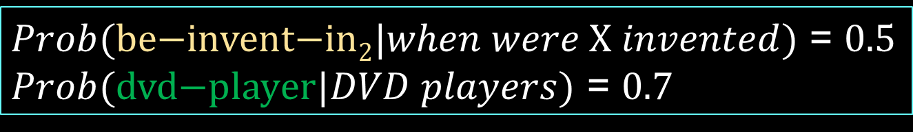
Open-Domain Question Answering
Fulfill user’s information need with direct answers
Semantic Parsing for Single-relation Questions [ACL-14]
$Q=$ “When were DVD players invented?”
$Prob(\text{be}\text{−}\text{invent}\text{−}\text{in}\text{2}|when were X invented)$ = $0.5$
$Prob(\text{dvd}\text{−}\text{player}|DVD players)$ = $0.7$
Semantic Matching via
Convolutional DSSM!

Slide 8

Multi-Relational Latent Semantic Analysis
$$f_{rel}(∎,∎)$$
~
×
×
~
Word Relation [EMNLP-12, EMNLP-13]
Knowledge Base Embedding [EMNLP-14]
Yih, Zweig & Platt. Polarity Inducing Latent Semantic Analysis. In EMNLP-CoNLL-12.
Chang, Yih & Meek. Multi-Relational Latent Semantic Analysis. In EMNLP-13.
Chang, Yih, Yang & Meek. Typed Tensor Decomposition of Knowledge Bases for Relation Extraction. In EMNLP-14.

Slide 9
Natural Language Understanding
Build an intelligent system that can interact with human using natural language
Research challenge
  Meaning representation of text
  Support useful inferential tasks
Semantic word representation is the foundation
  Language is compositional
  Word is the basic semantic unit

Slide 10
Continuous Semantic Representations
A lot of popular methods for creating word vectors!
  Vector Space Model [Salton & McGill 83]
  Latent Semantic Analysis [Deerwester+ 90]
  Latent Dirichlet Allocation [Blei+ 01]
  Deep Neural Networks [Collobert & Weston 08]
  Word2Vec [Mikolov+ 13]
Encode term co-occurrence information
Measure semantic similarity well

Slide 11
Continuous Semantic Representations
sunny
rainy
cloudy
windy
car
cab
emotion
sad
wheel
joy
feeling

Slide 12


Semantics Needs More Than Similarity
Tomorrow will be rainy.
Tomorrow will be sunny.
$similar($rainy, sunny$)$?
$antonym($rainy, sunny$)$?

Slide 13
Leverage Linguistic Knowledge Bases
Can’t we just use the existing linguistic KBs?
  Knowledge in these resources is never complete
  Often lack of degree of relations
Create a continuous semantic representation that
  Leverages existing rich linguistic knowledge bases
  Discovers new relations
  Enables us to measure the degree of multiple relations (not just similarity)

Slide 14
Roadmap
Background:
Latent Semantic Analysis (LSA)
Two opposite relations:
Polarity Inducing Latent Semantic Analysis (PILSA)
More relations:
Multi-Relational Latent Semantic Analysis (MRLSA)
Relational domain knowledge:
Typed MRLSA (TRESCAL)

Slide 15
Latent Semantic Analysis [Deerwester+ 1990]
Data representation
  Encode single-relational data in a matrix
    Co-occurrence (e.g., from a general corpus)
    Synonyms (e.g., from a thesaurus)
Factorization
  Apply SVD to the matrix to find latent components
Measuring degree of relation
  Cosine of latent vectors

Slide 16
Encode Synonyms in Matrix
Input: Synonyms from a thesaurus
Joyfulness: joy, gladden
Sad: sorrow, sadden
Target word: row-vector
Term: column-vector
 | joy | gladden | sorrow | sadden | goodwill
Group 1: “joyfulness” | 1 | 1 | 0 | 0 | 0
Group 2: “sad” | 0 | 0 | 1 | 1 | 0
Group 3: “affection” | 0 | 0 | 0 | 0 | 1
Cosine Score

Slide 17




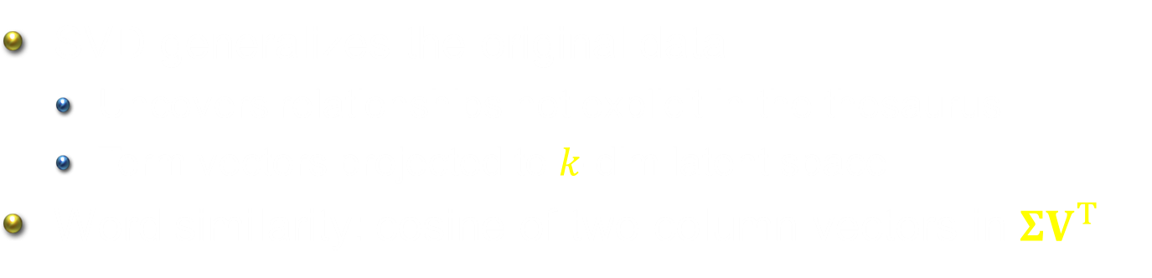



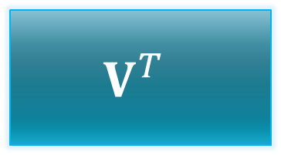

Mapping to Latent Space via SVD
terms
$$W$$
$$U$$
$$Σ$$
$$V^{T}$$
$$≈$$
$$k×k$$
$$k×n$$
$$d×n$$
$$d×k$$
SVD generalizes the original data
  Uncovers relationships not explicit in the thesaurus
  Term vectors projected to $k$-dim latent space
Word similarity: cosine of two column vectors in $ΣV^{T}$

Slide 18
Problem: Handling Two Opposite Relations
Synonyms & Antonyms
LSA cannot distinguish antonyms [Landauer 2002]
  “Distinguishing synonyms and antonyms is still perceived as a difficult open problem.” [Poon & Domingos 09]
Idea #1: Change the data representation

Slide 19
Polarity Inducing LSA [Yih, Zweig & Platt 2012]
Data representation
  Encode two opposite relations in a matrix using “polarity”
    Synonyms & antonyms (e.g., from a thesaurus)
Factorization
  Apply SVD to the matrix to find latent components
Measuring degree of relation
  Cosine of latent vectors

Slide 20
Encode Synonyms & Antonyms in Matrix
Joyfulness: joy, gladden; sorrow, sadden
Sad: sorrow, sadden; joy, gladden
Target word: row-vector
 | joy | gladden | sorrow | sadden | goodwill
Group 1: “joyfulness” | 1 | 1 | 1 | 1 | 0
Group 2: “sad” | 1 | 1 | 1 | 1 | 0
Group 3: “affection” | 0 | 0 | 0 | 0 | 1

Slide 21

Encode Synonyms & Antonyms in Matrix
Joyfulness: joy, gladden; sorrow, sadden
Sad: sorrow, sadden; joy, gladden
Inducing polarity
Target word: row-vector
 | joy | gladden | sorrow | sadden | goodwill
Group 1: “joyfulness” | 1 | 1 | -1 | -1 | 0
Group 2: “sad” | -1 | -1 | 1 | 1 | 0
Group 3: “affection” | 0 | 0 | 0 | 0 | 1
Cosine Score: $+ Synonyms$

Slide 22

Encode Synonyms & Antonyms in Matrix
Joyfulness: joy, gladden; sorrow, sadden
Sad: sorrow, sadden; joy, gladden
Inducing polarity
Target word: row-vector
 | joy | gladden | sorrow | sadden | goodwill
Group 1: “joyfulness” | 1 | 1 | -1 | -1 | 0
Group 2: “sad” | -1 | -1 | 1 | 1 | 0
Group 3: “affection” | 0 | 0 | 0 | 0 | 1
Cosine Score: $− Antonyms$

Slide 23
Experiments: Data
Encarta Thesaurus
  Records synonyms and antonyms of target words
  Vocabulary of 50k terms and 47k target words
Evaluation: GRE closest-opposite questions [Mohammad+ 08]
  Dev: 162 questions
  Test: 950 questions

Slide 24
Results – GRE Antonym Test
Task: GRE closest-opposite questions
  Which is the closest opposite of adulterate?
  (a) renounce (b) forbid (c) purify (d) criticize (e) correct
Accuracy

Slide 25
Problem: How to Handle More Relations?
Limitation of the matrix representation
  Each entry captures a particular type of relation between two entities, or
  Two opposite relations with the polarity trick
Encoding other binary relations
  Is-A (hyponym) – ostrich is a bird
  Part-whole – engine is a part of car
Idea #2:
Encode multiple relations in a 3-way tensor (3-dim array)!

Slide 26
Multi-Relational LSA [Chang, Yih & Meek 2013]
Data representation
  Encode multiple relations in a tensor
    Synonyms, antonyms, hyponyms (is-a), … (e.g., from a linguistic knowledge base)
Factorization
  Apply tensor decomposition to the tensor to find latent components
Measuring degree of relation
  Cosine of latent vectors after projection

Slide 27
Encode Multiple Relations in Tensor
Represent word relations using a tensor
  Each slice encodes a relation between terms and target words.
gladden
gladden
joy
sadden
joy
sadden
feeling
feeling
joyfulness
1 | 1 | 0 | 0
1 | 1 | 0 | 0
0 | 0 | 1 | 0
0 | 0 | 0 | 0
joyfulness
0 | 0 | 0 | 0
0 | 0 | 1 | 0
1 | 0 | 0 | 0
0 | 0 | 0 | 0
gladden
gladden
sad
sad
anger
anger
Construct a tensor with two slices
Synonym layer
Antonym layer

Slide 28
Encode Multiple Relations in Tensor
Can encode multiple relations in the tensor
gladden
joy
sadden
feeling
1 | 1 | 0 | 0
1 | 1 | 0 | 0
0 | 0 | 1 | 0
0 | 0 | 0 | 0
1 | 1 | 0 | 0
1 | 1 | 0 | 0
0 | 0 | 1 | 0
0 | 0 | 0 | 0
0 | 0 | 0 | 1
0 | 0 | 0 | 0
0 | 0 | 0 | 1
0 | 0 | 0 | 1
joyfulness
gladden
sad
anger
Hyponym layer

Slide 29








Tensor Decomposition – Analogy to SVD
Derive a low-rank approximation to generalize the data and to discover unseen relations
Apply Tucker decomposition and reformulate the results
$$t_{1},t_{2},…, t_{n}$$
$$r$$
$$r$$
$$t_{1},t_{2},…, t_{n}$$
$$w_{1},w_{2},…, w_{d}$$
~
$$r$$
$$w_{1},w_{2},…, w_{d}$$
×
~
×
$$r$$
latent representation of words

Slide 30


Tensor Decomposition – Analogy to SVD
Derive a low-rank approximation to generalize the data and to discover unseen relations
Apply Tucker decomposition and reformulate the results
latent representation of a relation
$$t_{1},t_{2},…, t_{n}$$
$$r$$
$$r$$
$$r$$
$$R_{1},R_{2},…, R_{m}$$
$$t_{1},t_{2},…, t_{n}$$
$$R_{1},R_{2},…, R_{m}$$
$$r$$
$$w_{1},w_{2},…, w_{d}$$
~
$$r$$
~
×
~
×
~
×
×
$$r$$
$$r$$
latent representation of words

Slide 31
Measure Degree of Relation
Similarity
  Cosine of the latent vectors
Other relation (both symmetric and asymmetric)
  Take the latent matrix of the pivot relation (synonym)
  Take the latent matrix of the relation
  Cosine of the latent vectors after projection

Slide 32
Measure Degree of Relation
Raw Representation
$ant\left(\text{joy},\text{sadden}\right)=cos⁡\left(𝓦_{:,\text{joy},syn},𝓦_{:,\text{sadden},ant}\right)$
gladden
gladden
joy
sadden
joy
sadden
felling
felling
joyfulness
1 | 1 | 0 | 0
1 | 1 | 0 | 0
0 | 0 | 1 | 0
0 | 0 | 0 | 0
joyfulness
0 | 0 | 0 | 0
0 | 0 | 1 | 0
1 | 0 | 0 | 0
0 | 0 | 0 | 0
gladden
gladden
sad
sad
anger
anger
Synonym layer
Antonym layer

Slide 33
Measure Degree of Relation
Raw Representation
$ant\left(\text{joy},\text{sadden}\right)=cos⁡\left(𝓦_{:,\text{joy},syn},𝓦_{:,\text{sadden},ant}\right)$
gladden
gladden
joy
sadden
joy
sadden
felling
felling
joyfulness
1 | 1 | 0 | 0
1 | 1 | 0 | 0
0 | 0 | 1 | 0
0 | 0 | 0 | 0
joyfulness
0 | 0 | 0 | 0
0 | 0 | 1 | 0
1 | 0 | 0 | 0
0 | 0 | 0 | 0
gladden
gladden
sad
sad
anger
anger
Synonym layer
Antonym layer

Slide 34



Measure Degree of Relation
Latent Representation
$rel\left({\text{w}}_{i},{\text{w}}_{j}\right)=cos⁡\left(S_{:,:,syn}V_{i,:}^{T},S_{:,:,rel}V_{j,:}^{T}\right)$
Cos ( , )
×
×
$$r$$
$$w_{1},w_{2},…, w_{n}$$
$$R_{1},R_{2},…, R_{m}$$
~
$$r$$
~
~
×
×
~
$$r$$
$$S$$
$$V^{T}$$

Slide 35
Experiment: Data for Building MRLSA Model
Encarta Thesaurus
  Record synonyms and antonyms of target words
  Vocabulary of 50k terms and 47k target words
WordNet
  Has synonym, antonym, hyponym, hypernym relations
  Vocabulary of 149k terms and 117k target words
Goals:
  MRLSA generalizes LSA to model multiple relations
  Improve performance by combing heterogeneous data

Slide 36
Example Antonyms Output by MRLSA
Target | High Score Words
inanimate | alive, living, bodily, in-the-flesh, incarnate
alleviate | exacerbate, make-worse, in-flame, amplify, stir-up
relish | detest, abhor, abominate, despise, loathe
* Words in blue are antonyms listed in the Encarta thesaurus.

Slide 37
Results – GRE Antonym Test
Task: GRE closest-opposite questions
  Which is the closest opposite of adulterate?
  (a) renounce (b) forbid (c) purify (d) criticize (e) correct
Accuracy

Slide 38
Example Hyponyms Output by MRLSA
Target | High Score Words
bird | ostrich, gamecock, nighthawk, amazon, parrot
automobile | minivan, wagon, taxi, minicab, gypsy cab
vegetable | buttercrunch, yellow turnip, romaine, chipotle, chilli

Slide 39
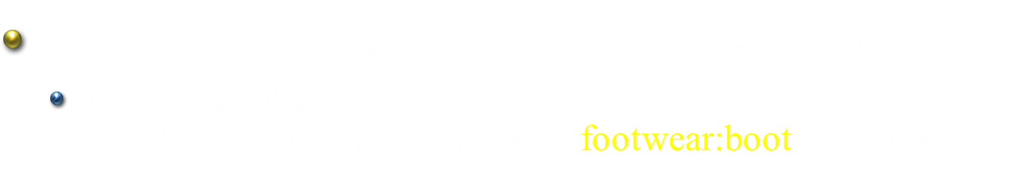
Results – Relational Similarity (SemEval-2012)
Task: Class-Inclusion Relation ($Y$ is-a kind of $X$)
  Most/least illustrative word pairs
  (a) art:abstract (b) song:opera (c) footwear:boot (d) hair:brown
Accuracy

Slide 40
Problem: Use Relational Domain Knowledge
Relational domain knowledge – the entity type
  Relation can only hold between the right types of entities
    Words having is-a relation have the same part-of-speech
    For relation born-in, the entity types are: (person, location)
Leverage type information to improve MRLSA
Idea #3: Change the objective function

Slide 41
Typed Multi-Relational LSA (TRESCAL)
[Chang, Yih, Yang & Meek, 2014]
Only legitimate entities are included in the objective function of tensor decomposition
Benefits of leveraging the type information
  Faster model training time
  Higher prediction accuracy
Experiments conducted using knowledge base
  Application to Relation Extraction

Slide 42
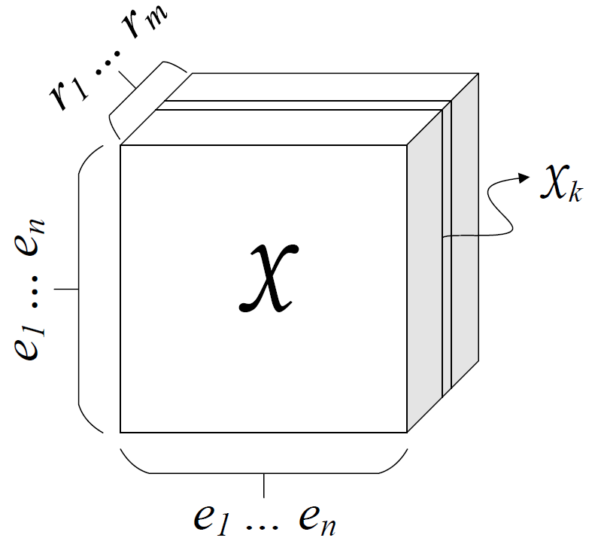

Knowledge Base Representation (1/2)
Collection of subj-pred-obj triples – $(e_{1}, r, e_{2})$
Subject | Predicate | Object
Obama | Born-in | Hawaii
Bill Gates | Nationality | USA
Bill Clinton | Spouse-of | Hillary Clinton
Satya Nadella | Work-at | Microsoft
… | … | …
$n$: # entities, $m$: # relations

Slide 43




Knowledge Base Representation (2/2)
$k$-th slice
$$𝒳_{k}$$
Hawaii
Obama
1
A $0$ entry means:
  Incorrect (false)
  Unknown
$R_{k}$ : born-in

Slide 44
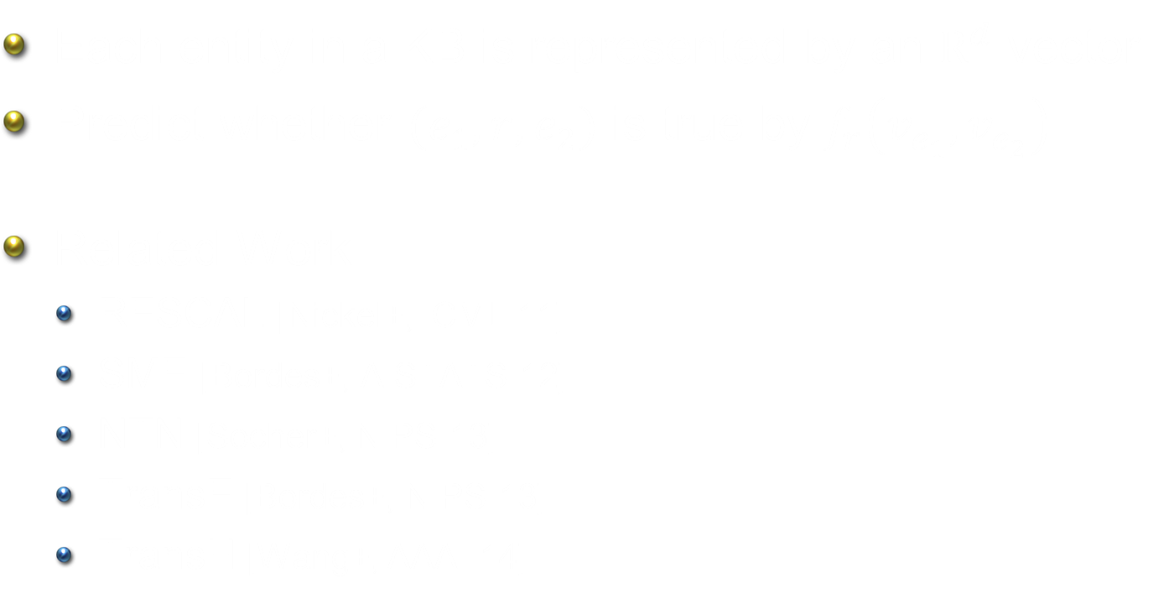
Knowledge Base Embedding
Each entity in a KB is represented by an $R^{d}$ vector
Predict whether $(e_{1}, r, e_{2})$ is true by $f_{r}\left(v_{e_{1}}, v_{e_{2}}\right)$
Related Work
  RESCAL [Nickel+, ICML-11]
  SME [Bordes+, AISTATS-12]
  NTN [Socher+, NIPS-13]
  TransE [Bordes+, NIPS-13]
  TransH [Wang+, AAAI-14]

Slide 45





Tensor Decomposition Objective
$$\frac{1}{2}\sum_{k}{{\left\|𝒳_{k}−Aℛ_{k}A^{T}\right\|}_{F}^{2}}+\frac{1}{2}\left({\left\|A\right\|}_{F}^{2}+\sum_{k}{{\left\|ℛ_{k}\right\|}_{F}^{2}}\right)$$
Objective:
$$𝒳_{k}$$
$$A$$
$$ℛ_{k}$$
$$A^{T}$$
~
×
×
~
RESCAL [Nickel+, ICML-11]

Slide 46




Training Procedure –
Alternating Least-Squares (ALS) Method
Fix $ℛ_{k}$, update $A$
$$A←\left[\sum_{k}{𝒳_{k}Aℛ_{k}^{T}+𝒳_{k}^{T}Aℛ_{k}}\right]{\left[\sum_{k}{B_{k}+C_{k}+λI}\right]}^{−1}$$
where $B_{k}=ℛ_{k}A^{T}Aℛ_{k}^{T}\text{, }C_{k}=ℛ_{k}^{T}A^{T}Aℛ_{k}$.
Fix $A$, update $ℛ_{k}$
$$vec\left(ℛ_{k}\right)←{\left(Z^{T}Z+λI\right)}^{−1}Z^{T}vec\left(𝒳_{k}\right)$$
where $vec\left(⋅\right)$ is vectorization,
$Z=A⨂A$ and $⨂$ is the Kronecker product.

Slide 47

Typed Tensor Decomposition Objective
$$\frac{1}{2}\sum_{k}{{\left\|𝒳_{k}^{′}−A_{l}ℛ_{k}A_{r}^{T}\right\|}_{F}^{2}}$$
Objective:
locations
$$𝒳_{k}$$
$$A$$
$$ℛ_{k}$$
$$A^{T}$$
~
×
×
~
persons
Relation: born-in

Slide 48
Typed Tensor Decomposition Objective
$$\frac{1}{2}\sum_{k}{{\left\|𝒳_{k}^{′}−A_{l}ℛ_{k}A_{r}^{T}\right\|}_{F}^{2}}$$
Objective:
$$𝒳_{k}$$
$$A$$
$$ℛ_{k}$$
$$A^{T}$$
~
×
×
~
Model training time: 4.6 times faster than RESCAL

Slide 49
Experiments – KB Completion
KB – Never Ending Language Learning (NELL)
  Training: version 165
  Developing: new facts between v.166 and v.533
  Testing: new facts between v.534 and v.745
# Entities | 753k
# Relation Types | 229
# Entity Types | 300
# Entity-Relation Triples | 1.8M

Slide 50
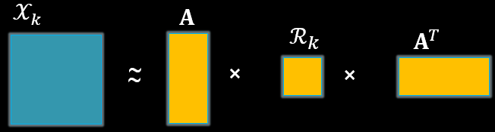
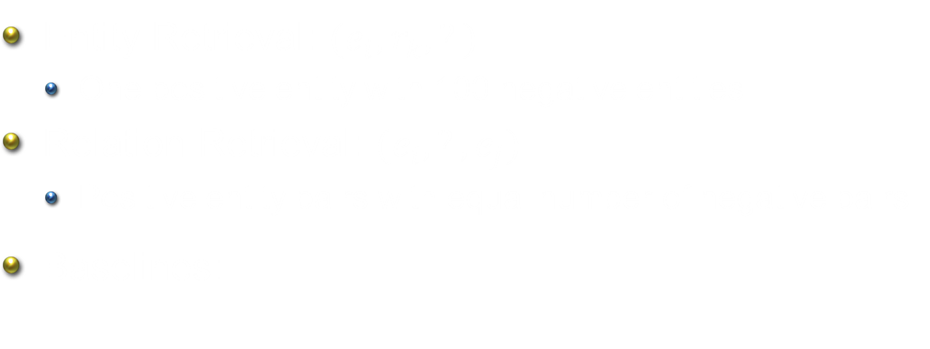



Tasks & Baselines
Entity Retrieval: $(e_{i}, r_{k}, ?)$
  One positive entity with 100 negative entities
Relation Retrieval: $(e_{i}, ?, e_{j})$
  Positive entity pairs with equal number of negative pairs
Baselines:
$$r_{k}$$
$$e_{i}$$
$$e_{j}$$
RESCAL
TransE

Slide 51
Entity Retrieval

Slide 52
Relation Retrieval

Slide 53

Experiments – Relation Extraction
Dan Roth is a professor at UIUC.
(Dan Roth, work-at, UIUC)

Slide 54
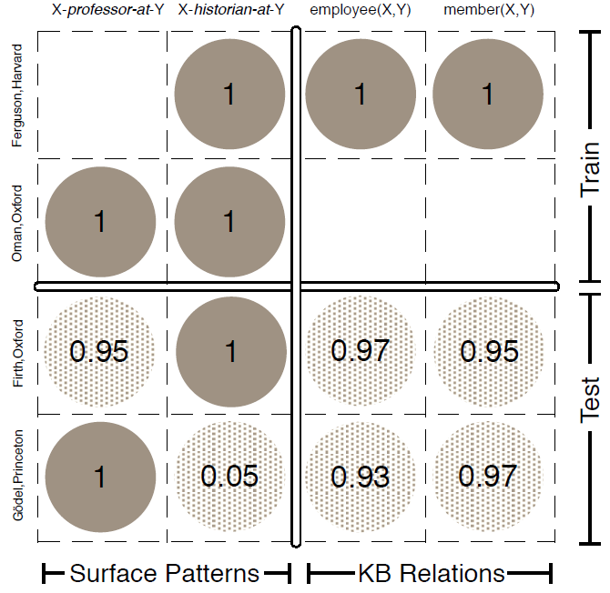
Relation Extraction as Matrix Factorization
[Riedel+ 13]
Row: Entity Pair
Column: Relation
Fig.1 of [Riedel+ 13]

Slide 55
Task: Find Entities that Have a Given Relation

Slide 56
Conclusions
Continuous semantic representation that
  Leverages existing rich linguistic knowledge bases
  Discovers new relations
  Enables us to measure the degree of multiple relations
Approaches
  Better data representation
  Matrix/Tensor decomposition
  Relational domain knowledge
Challenges & Future Work
  Capture more types of knowledge in the model
  Support more sophisticated inferential tasks

Slide 57
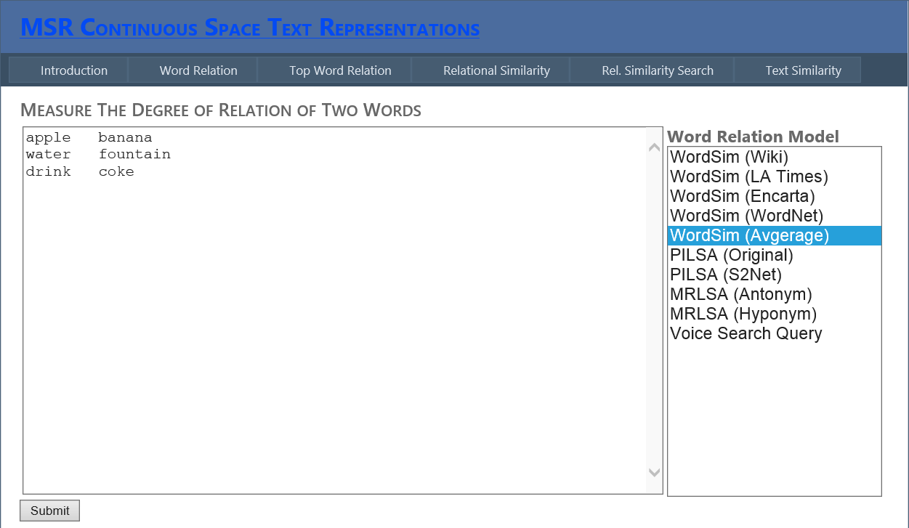

Demo and Web Service
MSR Continuous-Space Text Representations
http://msrcstr.cloudapp.net/

